Slide 1

Welcome to Curriculum Night
Please sign in before you sit down.

Slide 2

PBIS
Be Responsible
Be Respectful
Be Safe
Be Polite
BEe Extraordinary!!!!

Slide 3
PBIS
Our school adopted the Positive Behavior Interventions and Supports plan several years ago. It focuses on reinforcing positive behavior in the school and classroom.
PBIS rewards – students can earn individual bees for their hive and class bees for demonstrating good character and following expectations.
Rank Achievements- In addition to the PBIS rewards our class is working on achievements to move up from citizen to Page to Squire to Knighthood (at the end of the year.) Most students have already earned their rank of Page and will have their ceremony on Friday. While most of these achievements are character based there are also academic goals attached. For the last semester, there will be an at home piece of their rank. You will be weighing in on specific behaviors at home that are “Knightly”.

Slide 4
Testing Brochures
Our students are assessed in a variety of ways throughout the year and different grade levels have different tests to take. This can become confusing. To help you navigate the assessment processes, Ms. Brice has created a testing brochure with lots of details regarding assessments your child will be taking throughout the year. Please take one on your way out tonight.

Slide 5
Daily Schedule
7: 30-8:00- Morning arrival/Morning Work
8:05-8:45- Specials
8:50-10:30- Math
10:30-10:50 Staggered Lunch (Ours is at 10:40)
10:50-11:50- Staggered Recess
12:00-12:50- RTI
12:50-1:00- Snack/Restrooms
1:00-2:30-Literacy
2:30-3:00- Social Studies/Science

Slide 6
Personalized Learning
Personalized Learning in Charlotte-Mecklenburg Schools aims to develop the whole child and empower them to take ownership of their learning by providing them with multiple pathways to demonstrate mastery learning in order to be successful and productive 21st century citizens in an ever-changing world.
We will be trying our hand at this for some units but not all as I will be learning this process along with the students.

Slide 7
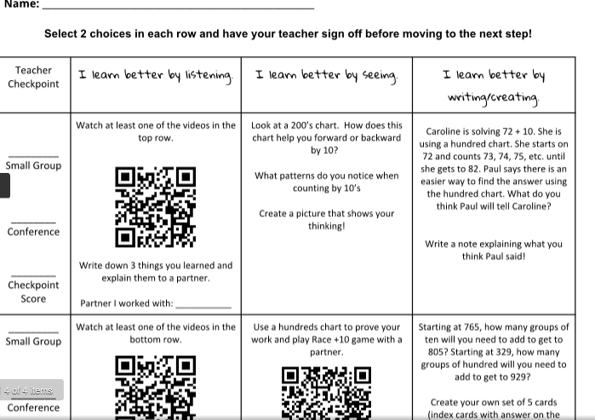
Pathway Example

Slide 8
Math
In Math we will focus on adding/subtracting, coins, time, place value, patterns, problem solving skills, geometry, data analysis, and measurement in standard units.
Math Facts- practice, practice, practice
Students will need to be fluent in math combinations to be successful in composing and decomposing numbers.
It is also important to help your child write numbers correctly.

Slide 9

Math Workshop
  Workshop will be differentiated based on individual needs and specific standards.
  This class will be using the Personalized Learning model for several units.

Slide 10

The Balanced Literacy Block contains the following:
1. Shared Reading and Phonics
2. Reader’s Workshop
3. Word Work
4. Interactive Read Aloud
5. Writer’s Workshop

Slide 11
Shared Reading
The teacher and students read the same text that is projected or on a chart. Students follow along while teacher reads aloud inviting them to join in from time to time. During this time, you have the flexibility to include other subject areas while infusing vocabulary development, targeted strategy/skill, etc. We also take this time to focus on blending, decoding, and fluency.

Slide 12
Reader’s Workshop
During this time, students are reading independently and responding to text, meeting with teacher in a Guided Reading group, interacting with other students in a book club/discussion or partnerships, and building their vocabulary.
Students may also use the computer or iPad to support their independent reading.

Slide 13
Word Study / Phonics
Students will be provided effective instruction in phonics, spelling and vocabulary using the Making Meaning and Words Their Way programs in addition to other resources. Word Study will engage students in purposeful, meaningful and motivational activities rather than have students commit to memorizing a set of words. All Spelling work will be completed in the classroom.
Vocabulary in all subject areas will be a main focus as well.

Slide 14
Interactive Read Aloud
The teacher reads aloud text and shares their own thoughts/ideas at significant points while the students are actively listening and responding to brief discussions.
Interactive Reading versus reading out loud
An instructional read aloud with “accountable talk”
Experienced readers engage and think about text as they read

Slide 15
Writing
Students will practice different styles of writing including:
    Narrative writing
    Realistic Fiction
    Expository texts- How-To Books
    Argumentative Writing – Share your opinion
    Poetry
    Informative Writing – Research and teach about a topic

Slide 16
Science
We have four big ideas that we will learn about in Science this year. Each one will incorporate science experiments, exploration, and hands on learning.
    Weather
    Life Cycles
    Matter
    Sound

Slide 17

Social Studies
Our social studies curriculum is called Exploring Where & Why: Communities Here and There. We use hands-on materials such as: globes, maps, atlases and online resources to develop 21st century skills in social studies.
Our major concepts this year include: communities, map skills, government, culture and history.

Slide 18
Homework
Each week your child will be responsible for homework in the following areas:
      A passage to be used all week with Text-Dependent Questions. Students will complete a question each day.
      Math – spiraling review for daily reinforcement.
      A weekly page from our newly purchased (thanks, PTA) language arts books. These books focus on grammar and punctuation.
It will be your child’s responsibility to take their agenda and homework to and from school each day.
RAZ kids, Dreambox and Front Row will be able to be accessed from home with your child’s login information. We are still in the process of collecting and organizing those passwords for the students. This should be going home by the end of next week.

Slide 19

Reading Challenge Changes
      Students will be earning points for the quality of their answers for the Text Dependent Questions from the reading passage homework. The goal is for students to earn between 12 and 16 points. These points correlate with proficiency levels on their report cards.
      4 point answer: Complete sentences with two or more details or evidences from the reading passage
      3 point answer: Complete sentences with at least one detail from the reading passage.
      2 point answer: Simple sentence with basic answer but no details.
      1 point answer: One word or a small phrase. Incomplete answer.

Slide 20
……………..
Student Homework Journal - A Letter to the Parents……………..
Dear Parents,
This is your child’s homework binder/folder. The homework assigned is designed to spiral back through the curriculum so students are always practicing their skills. During the first few weeks of school we will train the students in the homework spiral and assist them in these tasks. We expect the students to do their homework to the best of their abilities BY THEMSELVES. This will be a difficult challenge at first, but will become easier and easier as the year progresses. Students should not get upset if the work seems difficult at first, and should make their best attempt on the tasks. We need to see their thinking and mistakes to better know how to teach them. We consistently check for homework completion and accuracy every day. So your child must have their binder with completed daily homework each day. Your child should never have more than 30 minutes of homework per night.
The homework is as follows:
Math - 9 problems a night, Mon.-Thurs. (Periodically they may have additional problems depending on the topics and skills we study.)(10 minutes)
Grammar – Weekly Grammar Daily Skill Practice, Mon.-Thurs. (5 minutes)
Reading – read an assigned text (article, passage, book, poem, etc.) and complete a text based question Mon-Thurs. based on that assignment (the text will remain the same all week) (15 minutes)
Periodically, a project based activity will be required and will replace regular daily homework for that time frame.
If you have any questions, comments, or concerns regarding homework, please email your child’s teacher at her school email.
2nd Grade Team

Slide 21
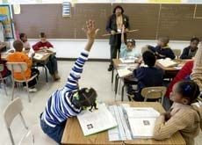
Sample Reading Passage CONCEPTS OF COMPREHENSION: FIGURATIVE LANGUAGE 2nd GRADE UNIT
Welcome Back!
Do you have butterflies in your stomach before the first day of school?
That means you are nervous. Don't worry!
Put Your Best Foot Forward
You are heading in the right direction if you put your best foot forward! These students are
That saying means you have a positive attitude. A good attitude helps you are paying attention make friends and get along better with others. ready to learn and
in class.
Put on Your Thinking Cap
Have you put on your thinking cap at school? That saying means you are ready
to learn and pay attention in class. You should always ask questions if you do not understand something.
Lend a Hand
If someone asks you to lend a hand, that saying means the person needs your help. You should help out at home, school, and in your neighborhood. What are some ways you can help others?
Catch Some Zzz's
Have you been catching some zzz's? That saying means you should get enough sleep. Sleeping helps you do your best. Second graders need about nine hours of sleep each night.

Slide 22
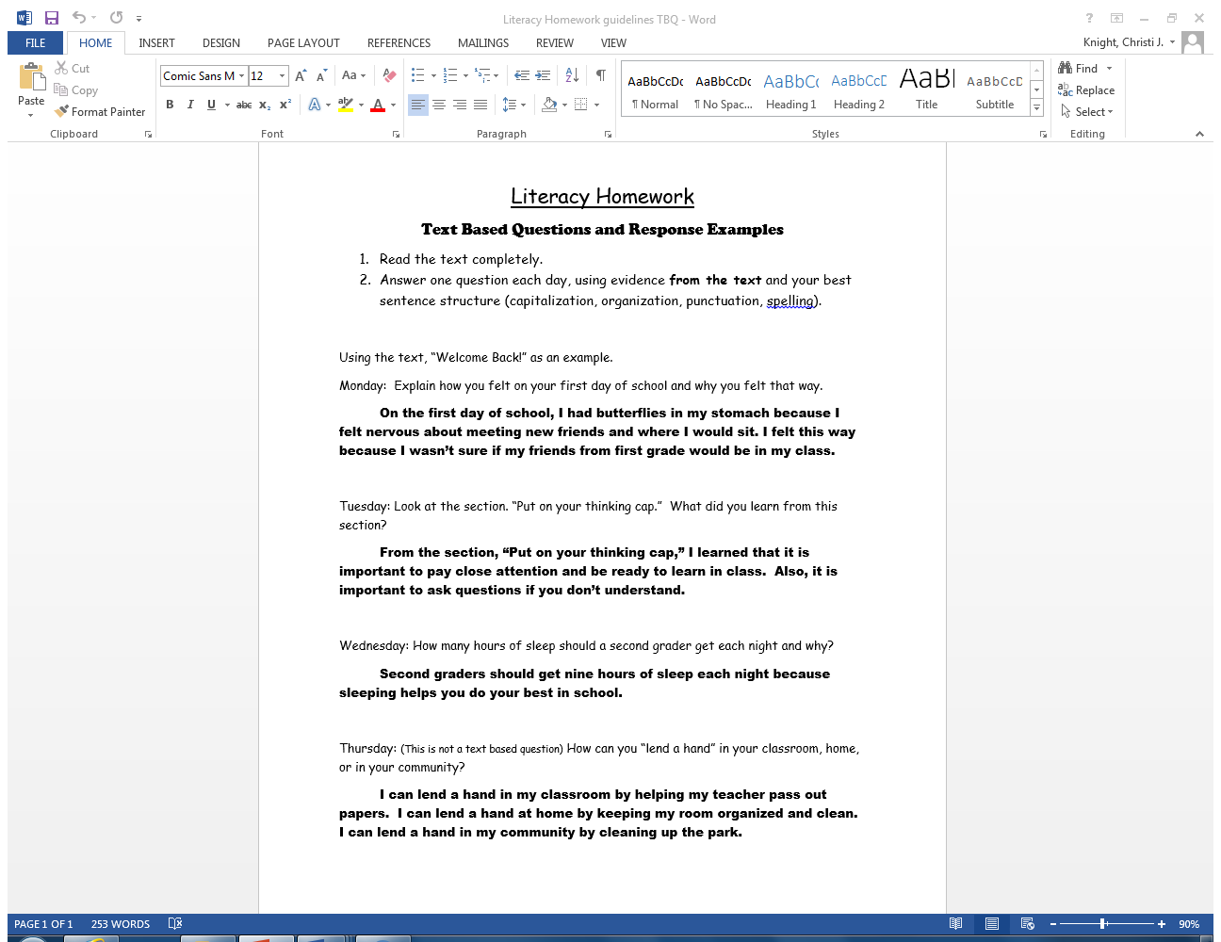
Text Dependent Questions
Literacy Homework: Text Based Questions and Response Examples
Read the text completely.
Answer one question each day, using evidence from the text and your best sentence structure (capitalization, organization, punctuation, spelling).
Using the text, “Welcome Back!” as an example.
Monday: Explain how you felt on your first day of school and why you felt that way.
On the first day of school, I had butterflies in my stomach because I felt nervous about meeting new friends and where I would sit. I felt this way because I wasn’t sure if my friends from first grade would be in my class.
Tuesday: Look at the section. “Put on your thinking cap.” What did you learn from this section?
From the section, “Put on your thinking cap,” I learned that it is important to pay close attention and be ready to learn in class. Also, it is important to ask questions if you don’t understand.
Wednesday: How many hours of sleep should a second grader get each night and why?
Second graders should get nine hours of sleep each night because sleeping helps you do your best in school.
Thursday: (This is not a text based question) How can you “lend a hand” in your classroom, home, or in your community?
I can lend a hand in my classroom by helping my teacher pass out papers. I can lend a hand at home by keeping my room organized and clean. I can lend a hand in my community by cleaning up the park.

Slide 23
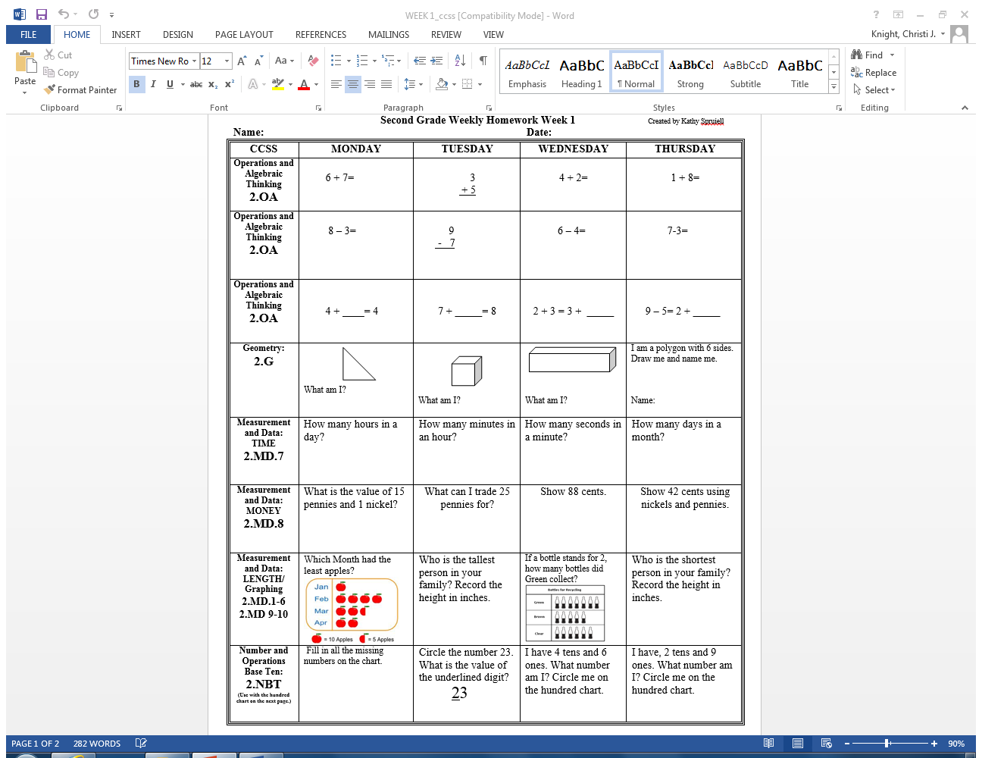
Math Spiral Review

Slide 24
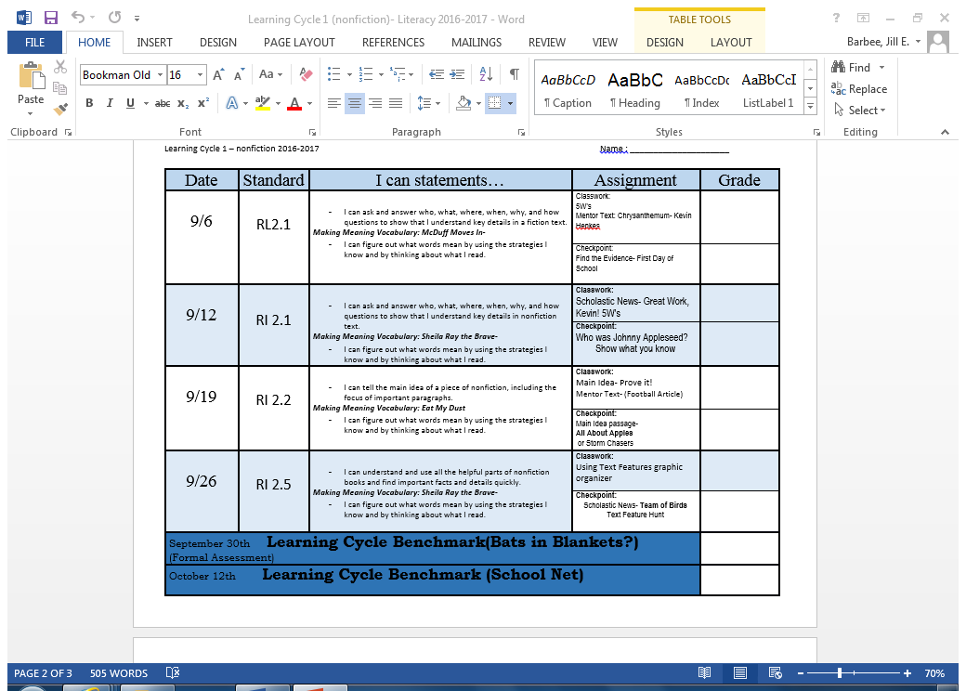
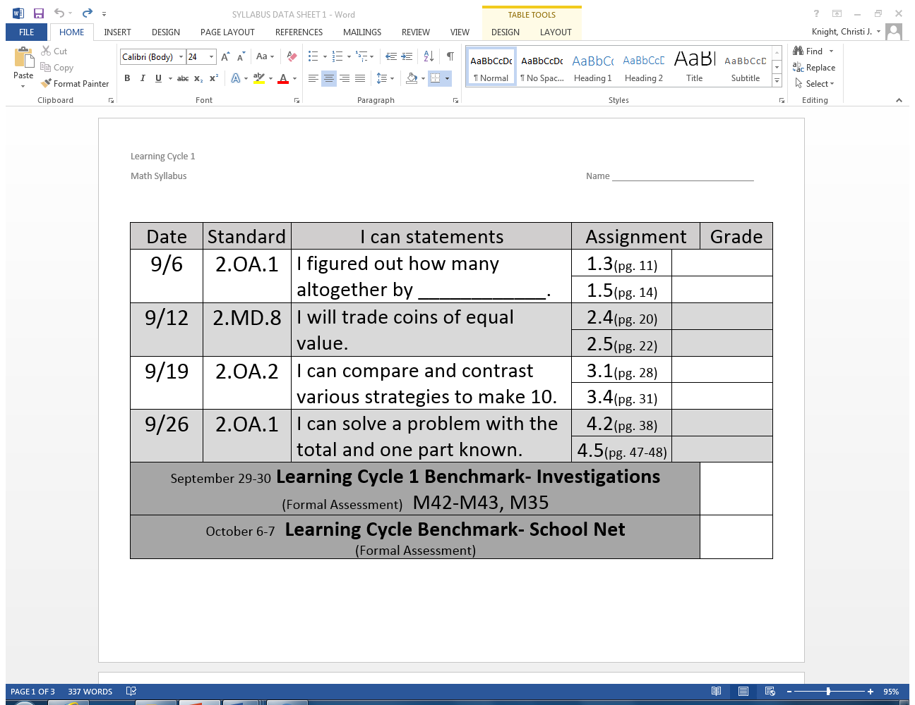
Syllabus

Slide 25
Thursday Folders
We will use Thursday Folders again this year. Please make sure that they are emptied each Thursday and returned to school on Friday.
Your child’s graded work and important information will be in this folder and should be reviewed with your child.
Please know that we will have already gone over graded work and your child does not need to correct it and return it.

Slide 26
Progress Reports and Report Cards
Progress Reports will go home mid quarter .
Reports Cards will go home at the end of the quarter.
Students will be assessed on a 3,2,1 scale.
  3=Consistently meets 2nd Grade standard mastery
  2=Inconsistently meets 2nd Grade standard mastery
  1=Needs to make great progress to meet standard mastery

Slide 27
Communication
My website is classknight@weebly.com This is where you will find the information for what units of study we are working on and other information. I will send a reminder that it has been updated
My email is Christi.knight@cms.k12.nc.us
. DOJO- We have finished our in class testing for now and DOJO will be up and running. This is a great way to keep in touch. I have sent an invite to all parents. Please connect.

Slide 28
Closing
Newsletters will be on my weebly monthly with weekly updates when needed.
I will send out an email each week.
Please let me know if I do not have this information from you.

